Slide 1

Programming One (csc7050)
Aidan McGowan
Interfaces

Slide 2

Interfaces
As we have already learned, objects define their interaction with the outside world through the methods that they expose.
Methods form the object's interface with the outside world; the buttons on a TV remote, for example, are the interface between you and the electrical wiring on the other side of the TV. You press the "power" button to turn the television on and off.

Slide 3
Java interfaces
In its most common form, an interface is a group of related methods with empty bodies.
Implementing an interface allows a class to become more formal about the behaviour it promises to provide. Interfaces form a contract between the class and the outside world, and this contract is enforced at build time by the compiler. If your class claims to implement an interface, all methods defined by that interface must appear in its source code before the class will successfully compile.

Slide 4
An interface is similar to a class in the following ways:
An interface can contain any number of methods.
An interface is written in a file with a .java extension, with the name of the interface matching the name of the file.
The bytecode of an interface appears in a .class file.
Interfaces appear in packages and their corresponding bytecode file must be in a directory structure that matches the package name.

Slide 5
An interface differs from a class in the following ways:
You cannot instantiate an interface.
An interface does not contain any constructors.
All of the methods in an interface are abstract.
An interface cannot contain instance fields. The only fields that can appear in an interface must be declared both static and final.
An interface is not extended by a class; it is implemented by a class.
An interface can extend multiple interfaces.

Slide 6
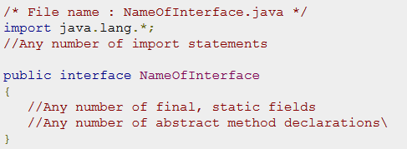
Declaring Interfaces:
The interface keyword is used to declare an interface. Here is a simple example to declare an interface:

Slide 7
Interfaces have the following properties:
An interface is implicitly abstract. You do not need to use the abstract keyword when declaring an interface.
Each method in an interface is also implicitly abstract, so the abstract keyword is not needed.
Methods in an interface are implicitly public.

Slide 8
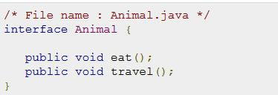
Example

Slide 9
Implementing Interfaces
When a class implements an interface, you can think of the class as signing a contract, agreeing to perform the specific behaviours of the interface. If a class does not perform all the behaviours of the interface, the class must declare itself as abstract.
A class uses the implements keyword to implement an interface. The implements keyword appears in the class declaration following the extends portion of the declaration.

Slide 10
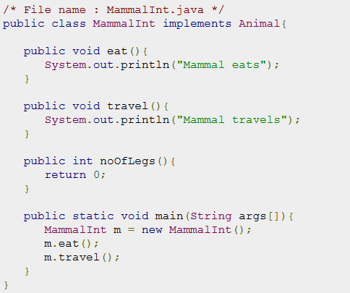

Implementation of an interface

Slide 11
When overriding methods defined in interfaces :
The signature of the interface method and the same return type or subtype should be maintained when overriding the methods.
Checked exceptions should not be declared on implementation methods other than the ones declared by the interface method or subclasses of those declared by the interface method.
An implementation class itself can be abstract and if so interface methods need not be implemented.

Slide 12
Interface exercise I
<<interface>> IPayable
+ calculateWages(hoursWorked : double, payRate : double)
Dashed line indicates an interface relationship
Employee
- name : String
Notes:
public interface IPayable {
public double calculateWages(double hoursWorked, double payRate);
}
________________________________________________________________________________________________
public class Employee implements IPayable {
private String name;
public Employee(){
}
@Override
public double calculateWages(double hoursWorked, double payRate) {
return hoursWorked * payRate;
}
/**
* @return the name
*/
public String getName() {
return name;
}
/**
* @param name the name to set
*/
public void setName(String name) {
this.name = name;
}
}
_________________________________________________________________________________________________________
public class PayrollManager {
public static void main(String[] args) {
Employee employee = new Employee();
employee.setName("Aidan");
System.out.printf("%s pay : £%.2f",employee.getName() ,employee.calculateWages(40.5, 33.23));
}
}

Slide 13
When implementing interfaces there are several rules
A class can implement more than one interface at a time.
A class can extend only one class, but implement many interfaces.
An interface can extend another interface, similar to the way that a class can extend another class.

Slide 14
Interface exercise II
<<interface>> IPrintable
printStatement()
BankAccount
- accNumber : int
BusinessAccount
- businessName : String
PersonalAccount
firstName : String lastName : String
Notes:
package InClassExcerise2;
public class BankAccount {
private int accNumber;
/**
* @return the accNumber
*/
public int getAccNumber() {
return accNumber;
}
/**
* @param accNumber the accNumber to set
*/
public void setAccNumber(int accNumber) {
this.accNumber = accNumber;
}
}
___________________________________________________________________________________________________________________
package InClassExcerise2;
public interface IPrintable {
public void printStatement();
}
___________________________________________________________________________________________________________________
package InClassExcerise2;
import InterfaceExamples.IPrintable;
public class BusinessAccount extends BankAccount implements IPrintable {
private String businessName;
public String getBusinessName() {
return businessName;
}
public void setBusinessName(String businessName) {
this.businessName = businessName;
}
@Override
public void printStatement() {
System.out.println("Business account statement (simulated ...)");
}
}
_______________________________________________________________________________________________________________
package InClassExcerise2;
public class BankAccount {
private int accNumber;
/**
* @return the accNumber
*/
public int getAccNumber() {
return accNumber;
}
/**
* @param accNumber the accNumber to set
*/
public void setAccNumber(int accNumber) {
this.accNumber = accNumber;
}
}
____________________________________________________________________________________________________________________
package InClassExcerise2;
public class BankMangerApp {
public static void main(String[] args) {
// create the Personal Account
Personal personalAcc = new Personal();
personalAcc.setFirstName("Jimmy");
personalAcc.setLastName("Nesbitt");
personalAcc.setAccNumber(11111);
// create Business Account
BusinessAccount busAcc = new BusinessAccount();
busAcc.setAccNumber(12345);
busAcc.setBusinessName("QUB");
busAcc.printStatement();
}
}

Slide 15
Extending Interfaces
An interface can extend another interface, similar to the way that a class can extend another class. The extends keyword is used to extend an interface, and the child interface inherits the methods of the parent interface

Slide 16
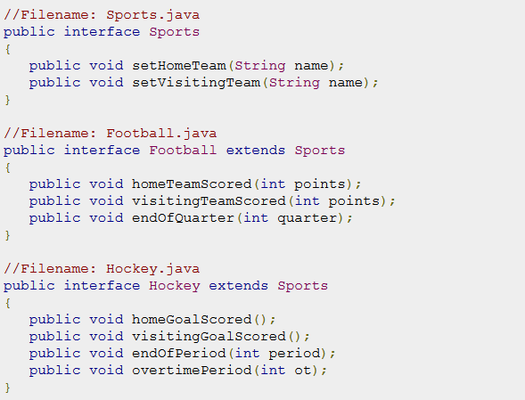
Extending Interfaces
The following Sports interface is extended by Hockey and Football interfaces
The Hockey interface has four methods, but it inherits two from Sports; thus, a class that implements Hockey needs to implement all six methods. Similarly, a class that implements Football needs to define the three methods from Football and the two methods from Sports.

Slide 17
Extending Multiple Interfaces
A Java class can only extend one parent class. Multiple inheritance is not allowed. Interfaces are not classes, however, and an interface can extend more than one parent interface.
The extends keyword is used once, and the parent interfaces are declared in a comma-separated list.
For example, if the Hockey interface extended both Sports and Event, it would be declared as:

